Slide 1
Information Systems
Analysis
Topic 3:
Soft Approaches to the Analysis of Information Systems
Notes:
NCC Education - Title Master

Slide 2
Scope and Coverage
This topic will cover:
  Types of soft approach analysis methodologies
  Advantages and disadvantages of soft approach analysis methodologies
  How soft approach methodologies can provide solutions to business problems
Notes:
NCC Education - Slide Master

Slide 3
Learning Outcomes - 1
By the end of this topic students will be able to:
  Define and explain the term soft approach to systems analysis
  Identify examples of soft approach methodologies
  Identify business situations where a soft approach to systems analysis might be appropriate

Slide 4
Learning Outcomes - 2
By the end of this topic students will be able to:
  Define and explain the abbreviation SSM
  Identify and discuss the advantages of SSM
  Identify and discuss the disadvantages of SSM
  Provide solutions to business problems using SSM

Slide 5
Terminology
  Terminology will be explained in the lecture, seminar and tutorial and you should take notes
  Ask questions if there is anything that you don’t understand

Slide 6
Soft Approach to Information Systems Analysis (SSM)
  SSM refers to Soft Systems Methodology.
  This approach to analysing Information Systems is a more people-focused analysis than is used when taking a hard approach.
  It recognises that user interaction is as important as technical considerations.
  Human activity is modelled as opposed to system activity in hard approaches.

Slide 7
When a Soft Approach might be Appropriate - 1
  Systems now tend to be described as ‘hard’ or ‘soft’. For example: a physical system such as an industrial plant can be described as a ‘hard’ system, whereas an organisational system or 'human activity' system is described as a ‘soft’ system.
  Soft approaches are useful for:
    Dealing with problems in complex, human situations
    When user, social, political and cultural issues need to be taken into account
    When greater interaction with users is required

Slide 8
When a Soft Approach might be Appropriate - 2
  Generally used for:
    information management
    information strategy
    business analysis

Slide 9
Steps when Undertaking SSM
  A number of stages can be followed when undertaking SSM:
    Analyse the existing information system and produce rich pictures
    Define a root definition of significant parts of the information system
    Produce conceptual models of the system
    Compare the concept of the system with the actual system
    Define and select feasible options for development
    Implement the new system

Slide 10
Techniques used when Undertaking SSM
  Unlike SSADM, the steps when undertaking SSM are not always followed in sequence and stages are often re-visited.
  A number of techniques can be followed when undertaking SSM:
    rich pictures (Step 1)
    root definitions (Step 2)
    conceptual models (Step 3)

Slide 11
Analyse the Existing Information System - 1
  A Systems Analyst consults with staff to create a rich picture of the existing information system.
  This picture represents a view of the whole system and can enable better planning and understanding of a system.
  Rich pictures are usually drawn by hand and include structures, processes, issues or developments.
  There are no rules or guidelines.

Slide 12
Analyse the Existing Information System - 2
  Elements of a rich picture include:
    customers, suppliers, competitors
    staff and their interactions
    departments
    processes
    products
    hardware and software resources
    boundaries
    interfaces

Slide 13
Analyse the Existing Information System - 3
  In addition to the main elements, the following aspects are also captured:
    social and cultural roles
    norms (expected behaviours), values and attitudes
    goals
    political and power roles and how they are obtained, used and transmitted
    problems, concerns

Slide 14
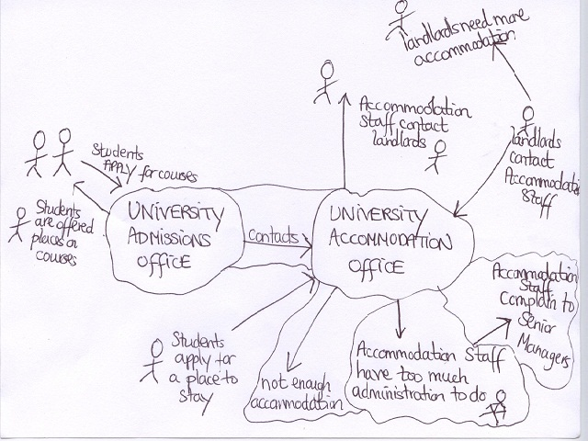
Rich Picture Example

Slide 15
Analyse the Existing Information System - 4
  There is no such thing as a right or wrong rich picture. There is a key difference between a rich picture and a formal diagram, such as a DFD – a rich picture does not attempt to model the system in any precise way.
  It should, however, represent the structure, processes and issues which are relevant to the day-to-day work at an organisation.
  There are usually several versions until the analyst decides upon the final one.

Slide 16
Analyse the Existing Information System - 5
  The analyst documents any issues that are currently causing problems or may do so in the future and that they think should be looked at in further detail. For example:
    conflicts between departments
    lack of communication between departments
    lack of communication with suppliers

Slide 17
Analyse the Existing Information System - 6
  At this stage, the analyst’s role is to indicate problems rather than provide possible solutions.
  The analyst uses the rich picture to communicate the problem/s with the management of the organisation.
  The rich picture helps to move from thinking about the problem to thinking about what can be done about the problem.

Slide 18
Analyse the Existing Information System - 7
  During this stage, the analyst can also use techniques to gather information, such as:
    checklists
    questions
    PEST analysis
    SWOT analysis

Slide 19
Analyse the Existing Information System - 8
  After analysis staff at an organisation should be able to:
    view and understand their organisation more fully
    understand and evaluate their role more fully
    identify and discuss any problems
    discuss any changes needed

Slide 20
Define a Root Definition - 1
  After analysis, the analyst needs to provide root definitions.
  Root definitions help to clarify the system processes and any problems.
  They are short textual statements which describe the aims and functions of the potential system to be developed.
  There are two types of root definitions:
    Primary task root definitions that focus on system processes
    Issue-based root definitions that focus on system problems

Slide 21
Define a Root Definition - 2
  When defining root definitions, the analyst needs to ask the following questions:
    What does the system do? (aim of the system)
    How does the system do it? (means of achieving the aim)
    Why is it being done? (longer term aim)

Slide 22
CATWOE - 1
  CATWOE analysis helps when defining a root definition.
  It helps identify and categorise all the people, processes and external factors involved in the Information system that is being analysed. It stands for:
      C = Customers/Clients
      A = Actors/Agents
      T = Transformations
      W = World view
      O = Owners
      E = Environment
  We will study this in depth in Topic 5.

Slide 23
CATWOE - 2
  Questions relating to CATWOE analysis can include:
    Who are the customers of the system?
    Who are the users of the system?
    What is transformed (changed) by the system?
    Who owns, controls and pays for the system?
    What is the overall view of the system?
    What are the economic and/or social, political, technical and environmental constraints to the system?

Slide 24
Produce Conceptual Models -1
  The analyst uses the rich picture and root definition to construct a conceptual ‘ideal’ system that defines:
    the must have aspects of the system
    the desirable aspects of the system
  This conceptual model can be used to describe how the system should function and what activities are necessary for the processes to take place.
  It is not intended to be a design of a new system, it depicts a potential system (unlike a DFD).

Slide 25
Produce Conceptual Models - 2
  The system’s performance can be measured by applying the Three E’s:
    Efficacy: will the system work and will the transformation be achieved?
    Efficiency: - will it work with minimum resources?
    Effectiveness: - will the system achieve its longer term goals?

Slide 26
Compare the Concept of the System with the Actual System - 1
  The analyst compares the conceptual model with the actual/real system as illustrated in the rich picture.
  Various questions can be asked, such as:
    Does a particular activity in the conceptual model occur in the actual system?
    If yes, how?
    If no, why?
    Does it cause any problems in the actual system?

Slide 27
Compare the Concept of the System with the Actual System - 2
  Differences between the actual system and the model are noted and discussed with management.
  Required developments of the existing system are discussed.
  Necessary and feasible solutions are agreed.
  A new system is implemented.

Slide 28
Advantages of SSM
  SSM provides opportunity for the following:
    Open discussion of problems, perceptions and needs
    Different perspectives
    Joint problem solving
    User participation and commitment
    Bringing sectors of an organisation together

Slide 29
Disadvantages of SSM
  May not be appropriate for complex systems in large organisations due to economic and time constraints
  Can take a long time to reach agreement
  It can be difficult to manage
  It may not be taken seriously

Slide 30
References
  Avison D. and Fitzgerald G. (2002). Information Systems Development: Methodologies, Techniques and Tools, 3rd Edition. McGraw-Hill Education

Slide 31
Topic 3 – Soft Approaches to the Analysis of Information Systems
Any Questions?
Notes:
NCC Education - End Slide Master

